Slide 1
Entrepreneurship Development
Search for Business Idea

Slide 2
Sources for Ideas
Good understanding of economics and the economy.
Changing needs of the people in a locality/society.
Watching Emerging trends in the society.
Extensive travelling and a wide range of reading.
Visit to trade fairs and exhibitions displaying new products and services.

Slide 3
Sources for Ideas
Observing Markets for Product Analysis and Market Survey
Success stories of entrepreneurs or friends or relatives.
Consumers, existing products and services, distribution channel, the federal government (the files of patent office, in response to government regulations) , and research and development.

Slide 4
Sources for Ideas
Creativity
Creative thinking
Brainstorming

Slide 5
Sources for Ideas
Creativity
Every problem holds an opportunity
Problems are NOT excuses for giving up
Every problem has more than one solution
Think sideways
Creativity is FUN – you get more ideas in an uncritical atmosphere

Slide 6
Sources for Ideas
Brainstorming
A process of detaching analysis of ideas from the actual development of ideas.
Sometimes, non-conventional thinking to more ideas and may lead to the best solutions.

Slide 7
Selection of Product
Import restrictions ?
Have Substantial amount of experience in manufacture and marketing of certain products ?
Degree of profitability ?
Concessions available form the government for producing the product ? Incentives / concessions , liberal taxation policies ?
Product belongs to the Priority industries or SSS?
Listed by government for purchasing exclusively from SSS ?

Slide 8
Selection of Product
Market for the product ?
Product has export market ?
Product belong to Licensed category or Non- Licensed category ?
Product belongs to ancillary unit and serves as a major component for the parent industry ? Ready Demand ?
Special advantages :
Free trade zone ?
Backward areas with special incentives and concessions are made available for manufacture ?

Slide 9
The Adoption Process
Awareness
Interest
Evaluation
Trail
Adoption

Slide 10
Methods of Obtaining Product

Slide 11
Product Planning and Development Strategy
Four Basic Types of Opportunities for Sales Growth
Market Penetration
Market Development
Product Development
Diversification

Slide 12
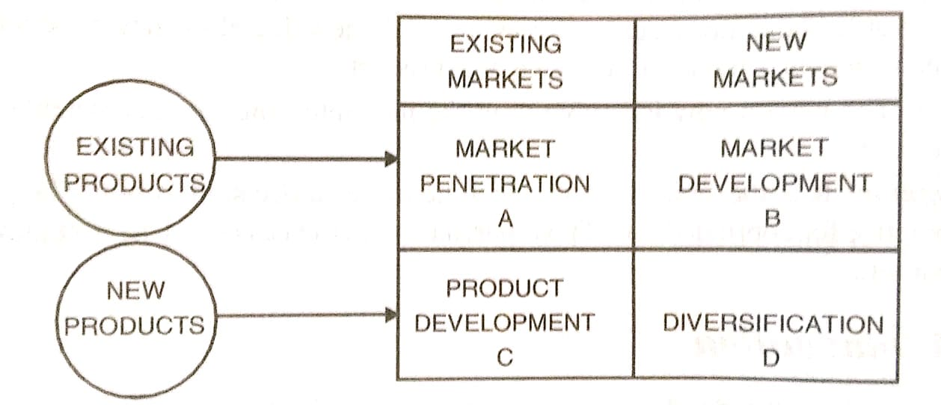
Product Planning and Development Strategy
Four Basic Types of Opportunities for Sales Growth

Slide 13
Product Planning and Development Process
New Product Ideas
Idea Screening
Concept Development and testing
Business Analysis
Product Development Programme
Test Marketing
Commercialization

Slide 14
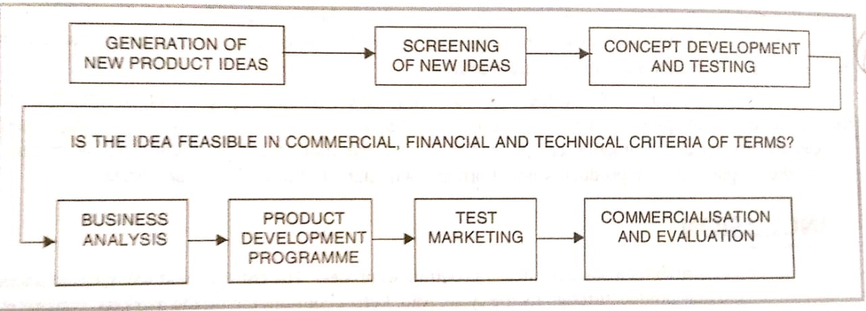
Product Planning and Development Process

Slide 15
New Product Idea

Slide 16
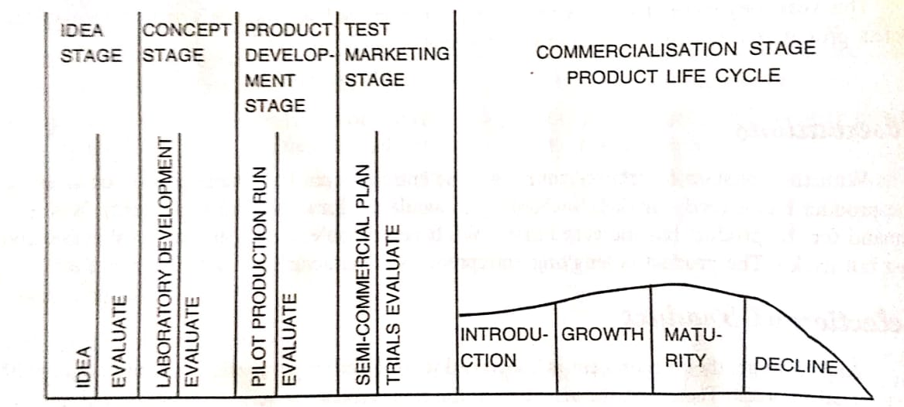
Product Planning and Development Process

Slide 17
Checklist for Choosing Ideas Fit with your skills and experience
Do you believe in the product or service?
Does the need it fits mean something to you personally?
Do you like and understand the potential customers?
Do you have experience in this type of business?
Do the basic success factors of this business fit your skills?
Are the tasks of the enterprise the ones you will enjoy doing yourself ?
Are the people the enterprise employ will enjoy working with and supervising ?
Has the idea begun to takeover your imagination and spare time ?
Is the idea innovative to the extent of social benefit ?
Are you expecting a good return ?

Slide 18
Checklist for Choosing Ideas Fit with Market
Is there a real customer need?
Can you get a price that gives you good margins?
Would customers believe in the product coming from your company?Does the product or service you propose produce clear perceivable customer benefit which is significantly better than
That offered by competing ways to satisfy the same basic need ?
Is there a cost effective way to get the message and the product to the customers ?

Slide 19
Checklist for Choosing Ideas Fit with the Enterprise
Is there a reason to believe your enterprise could be very good at the business?
Does it fit the enterprise culture?
Can you imagine who might sponsor it?
Does it look profitable (high margin-low investment)?
Will it lead to large markets and growth?

Slide 20
Checklist for Choosing Ideas What to do when your idea is rejected ?
Give up and select a new idea.
Listen carefully, understand what is wrong, improve your idea and your presentation, and try again.
Find someone else to whom you present your idea by considering:
Who will benefit most if it works and can they be a sponsor?
Who are the potential customers and will they demand the product?
How can you get to the people who really care about entrepreneurial ideas?

